Slide 1


Sentence Selection Chatbot for Ubuntu Dialog Corpus
Group 1
Aydar
Seungwoo Yoon
Chansu Park
Shinhyung Kim

Slide 2

Table of Contents
Motivation
Problem Description
Baseline Model
Our Model
Algorithm
Results
Conclusion

Slide 3
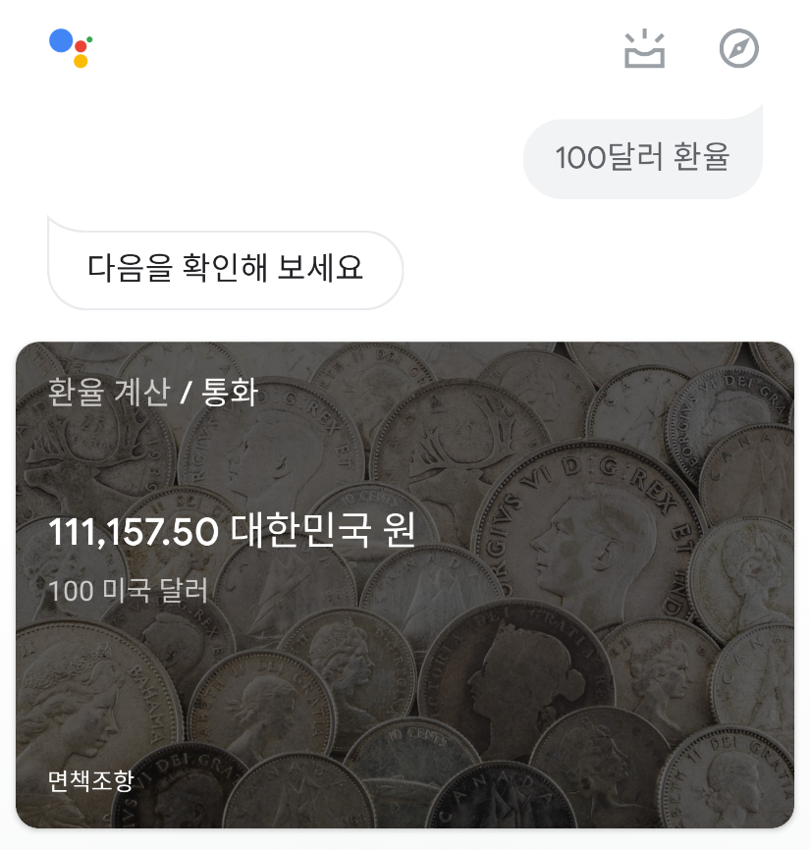
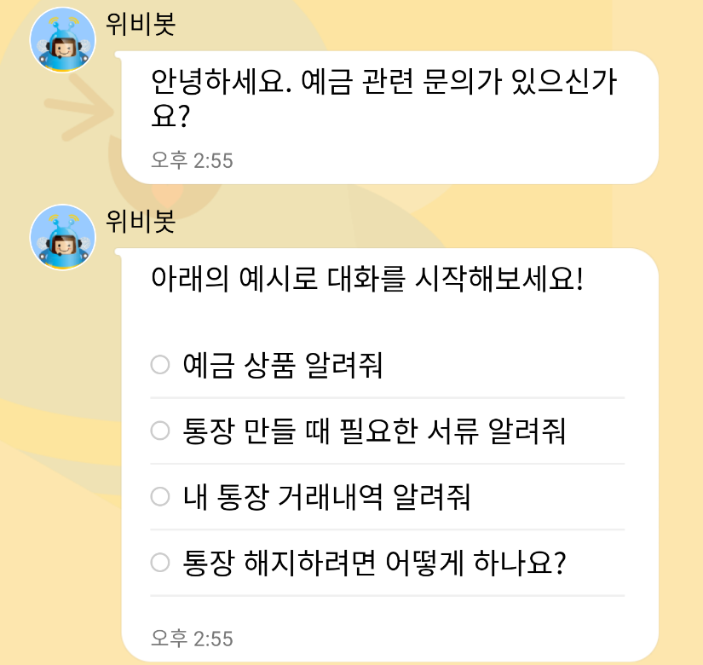
Motivation
Context/Goal recognition is important for AIs
- To interact with humans, robots have to understand what is needed for humans and have to answer/react properly
As an example, many companies launch their chatbots to solve customers requests automatically
Google Assistant
Wooribank
(Deposit/Savings part)

Slide 4
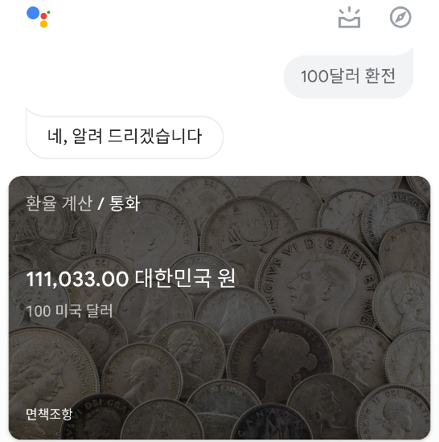
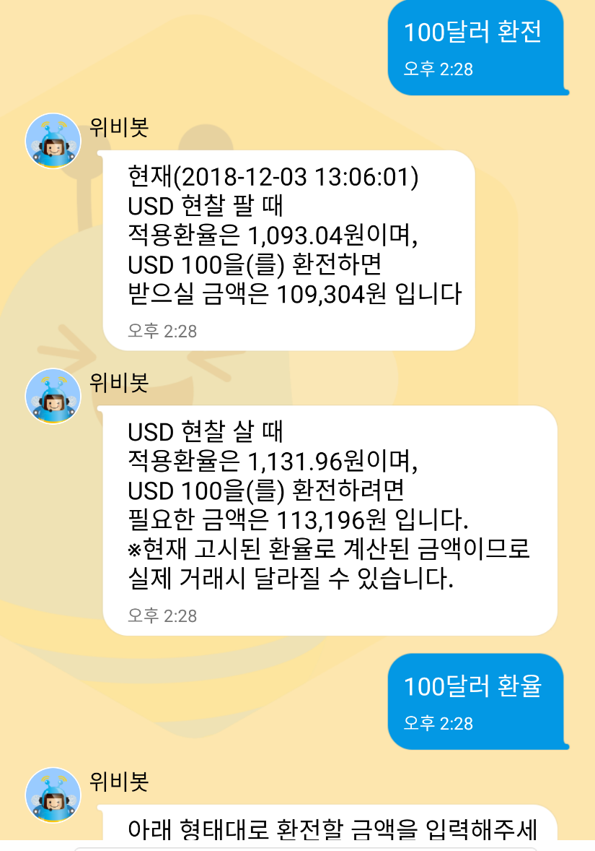
Motivation
Chatbots have to answer similarly for inputs having similar meaning.
Also, they somehow have to recognize not a full sentence, even with broken grammar or some typos/abbreviations.
Currently, some chatbots cannot do that.
← Succeed to ask 환전 (exchange), but failed to ask 환율(exchange rate)
This chatbot cannot recognize neither context nor similar words.
Acts same as previous slide

Slide 5
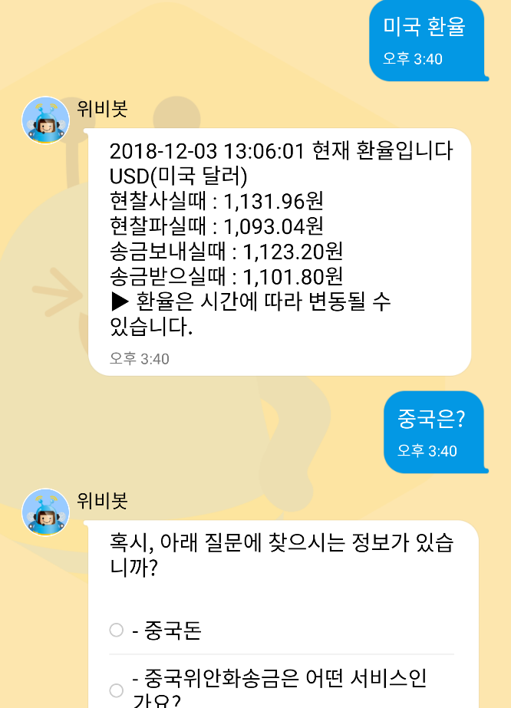
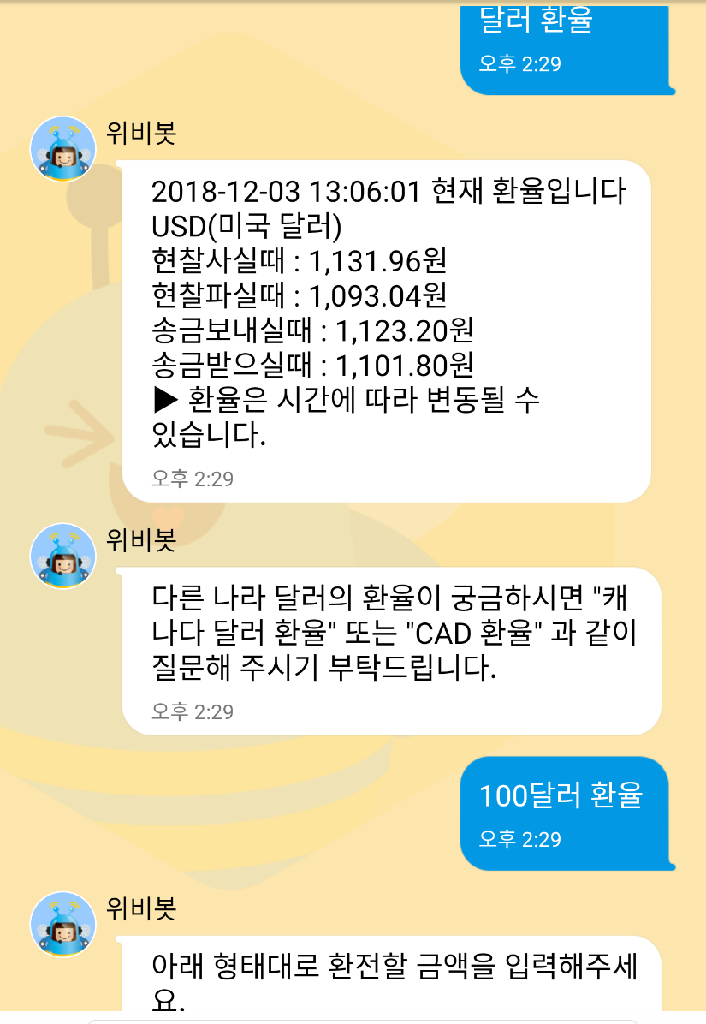
Motivation
Performance of some chatbot is awkward
← After asking 미국 환율 (dollar exchange rate), asking 중국은? (What about china?) makes failure to get an answer
← Succeed to ask 달러 환율 (dollar exchange rate), but failed to ask 100달러
This chatbot cannot recognize neither context nor similar usage.

Slide 6
Problem Description
Implement a chatbot which recognizes a two-person conversation including
(some) Wrong grammar
Typos
Expertized terminology (task-specific domain)
Text-based emojis
And then select right reaction from the answer pool,
which should not be hand-crafted, rule-based systems or based on hand-crafted features

Slide 7
Problem Description
Dataset: Ubuntu Dialogue Corpus ¹
collection of logs from Ubuntu-related chat rooms
prepared to solve an Ubuntu user’s posted problem
Details:
Task: select the next utterance from given candidate set
Candidate set will contain between 1 option that is correct and 99 options that are incorrect (for a total of 100).
Evaluation criteria: Correct accuracy of the results from Top n in 100 (n = 1, 2, 5, 10, 50)

Slide 8
Problem Description
=================== Context ===================
User1: ugh ubuntu wotn read my ipod... i can acess the harddrive but gtkpod wont recognize it.. :(
User2: Try rhythmbox. rhythmbox reads ipods nicely in breezy
User1: SEjeff, i can put songs on my ipod through rhythmbox?
=================== Correct Answer ===================
82: No, but I got gtkpod to work perfectly with my nano and breezy
=================== Example of utterances =================== 3: I doubt they would even consider giving support... __eou__
12: no __eou__
26: I'm not sure then. __eou__
41: ok, let that finish first then __eou__
67: use /join #kubuntu-de __eou__
82: No, but I got gtkpod to work perfectly with my nano and breezy __eou__
91: I dont know, you said it was 4yrs old, I thought you may know of the bug off hand. __eou__
98: itm must be in options - somewhere __eou__

Slide 9
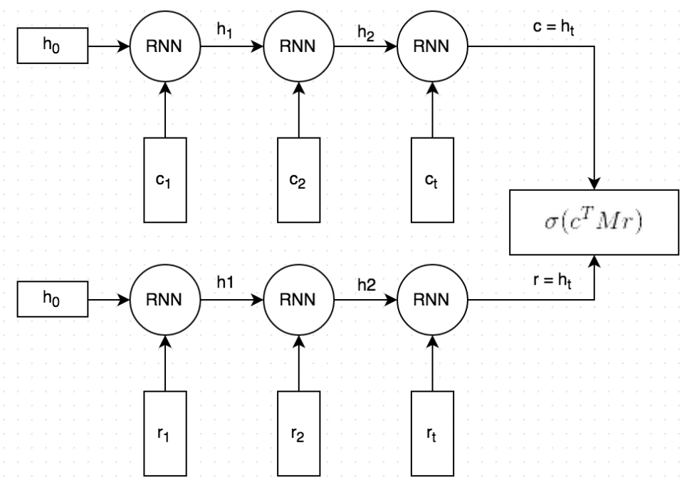
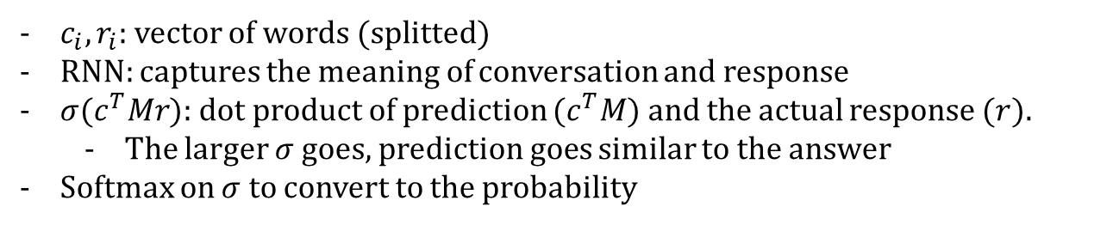
Baseline Model
conversation
probability
Softmax
100 responses
response
$c_{i}, r_{i}$: vector of words (splitted)
RNN: captures the meaning of conversation and response
$σ(c^{T}Mr)$: dot product of prediction ($c^{T}M$) and the actual response ($r$).
The larger $σ$ goes, prediction goes similar to the answer
Softmax on $σ$ to convert to the probability

